Slide 1
HND_Software Dev: Data Structures (H16Y 35)
Outcome 1_Prep Overview

Slide 2
Outcome 1_Mode of Assessment
This outcome is assessed using a knowledge based assessment designed to ensure that you have acquired the background knowledge required to develop skills in using data structures
Closed-book objective test consisting of 30 multiple-choice
Each question is worth 1 mark each, candidates required to achieve a minimum of 18 marks (i.e. 60%) to be successful.

Slide 3
Outcome 1_Overview
Representation of Simple and Structured Data types
Simple Data Types: Character, integer, floating point, Boolean, etc.
Structured Data Types: String, record, table, array [1D, 2D], etc.
Computer Memory Allocation
SMA
DMA
Data Representation in Computer Systems
Binary & Denary
ASCII representation
Boolean Logic operators
Floating Point numbers
Unicode
Standard File Types
Images, sounds, videos, compression, etc.
XML data file structures

Slide 4
Outcome 1_Revision (Key Points)
What do you understand by the following?
Simple data types
Structured data types
Dynamic Memory Allocation (DMA)
What is a root element of an XML data file ?
What is the purpose of XML ?
What is a complex XML element ?
Define the following
Arrays [1D, 2D]
Integers
Character
String
Boolean
Record
Floating Point
Table
Examples of C# codes showing use of different data types
Arrays [1D, 2D]
Floating points
Boolean
Integers

Slide 5
Boolean logic operators; (Logic Gates)

Slide 6
Boolean Operators
There are a total of seven Boolean Operators used for solving logic problems.
Four of these are called Simple Logic Gates, the other three are Composite Logic Gates.
You will be given a set of binary values and asked to evaluate the answer depending on which gate is used.
Computer operations consist of many thousands of these logic gates, processing values and returning results at very high speeds.

Slide 7
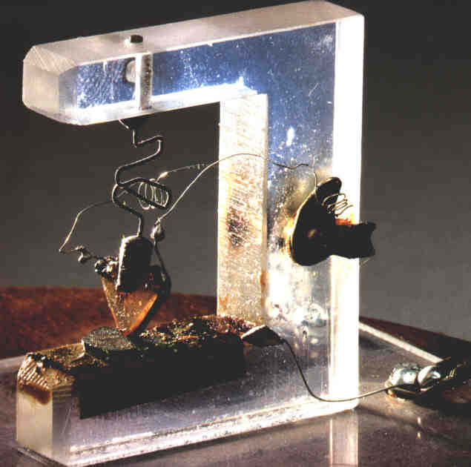
Boolean Logic Gates are built from transistors. These are tiny switches built of semiconductor material, usually silicon, but sometimes carbon molecules are used instead.
If the gate is open, no current can flow (0 state). If the gate is closed, current can flow (1 state).

Slide 8
The Simple Gates - NOT
The simplest gate of all is the NOT gate, or INVERTER
All this does is reverse the value that goes in.
The notation for a NOT gate looks like this -
Note the circle at the front of the NOT gate

Slide 9
Truth Table - NOT
The Truth Table for a NOT gate looks like this
Example - If x = 10 and y = 15
NOT X > 0 is FALSE
NOT X > Y is TRUE
We write NOT A as A

Slide 10
The Simple Gates - AND
The next gate is the AND gate. It always takes at least two inputs. All of the inputs have to be TRUE for the outcome to be TRUE.
The logic gate for an AND looks like this -

Slide 11
Truth Table - AND
The truth table for AND looks like this -
Example If x = 10, y = 15
(x > 0 AND y < 20) is TRUE
(x = 10 AND x > y) is FALSE
We write A AND B as A.B

Slide 12
The Simple Gates - OR
The next gate is the OR gate. It needs at least two inputs. But unlike the AND, only ONE of the inputs has to be TRUE for the outcome is to be TRUE.
The logic gate for an OR looks like this -

Slide 13
Truth Table - OR
The truth table for OR looks like this -
Example - If x = 10 and y = 15
x > 0 OR x < 20 is TRUE
x = 10 OR x > y is TRUE
We write A OR B as A+B
DO NOT confuse this with A PLUS B!
A | B | A+B
0 | 0 | 0
0 | 1 | 1
1 | 0 | 1
1 | 1 | 1

Slide 14
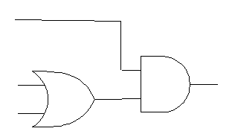

Let’s try some examples of Boolean Expressions.
Assume that x = 10, y = 15 and z = 20.
((x = 10) OR (y = 10)) AND (z > x)
z > x
X = 10
True
Y = 10

Slide 15
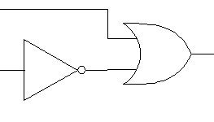
Assume that x = 10, y = 15 and z = 20.
(x = y) OR (NOT (x > z))
x = y
True
x > z

Slide 16
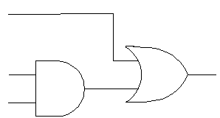

Assume that x = 10, y = 15 and z = 20.
((x = y) AND (x = 10)) OR (y > z)
y > z
x = y
False
x = 10

Slide 17
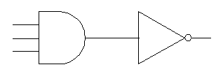
Assume that x = 10, y = 15 and z = 20.
NOT ((x > y) AND (z > y) AND (x < z))
x > y
z > y
x < z
True

Slide 18
As part of your assessment material, you will be asked to perform logical operations between pairs of binary numbers.
Example - Perform a logical AND operation between the numbers
0001 0100 0010 0011

Slide 19

A logical OR between same set of binary numbers -
1101 1110 1110 0011
0011 0101 0010 1111
1111 1111 1110 1111

Slide 20
Exclusive OR Gate - XOR
The next gate you need to be able to use is the XOR (exclusive OR) gate. Again, it needs at least two inputs. Unlike the AND and OR, it needs the inputs to be DIFFERENT from each other for the output to be TRUE.
If all of the inputs are the same, whether they are true or false, the output will be FALSE.
The logic gate for an XOR looks like this -
Note the double line at the base of this diagram, which always signifies an XOR gate!

Slide 21
Truth Table - XOR
The truth table for XOR looks like this -
Example - If x = 10, y = 15
(x > 0 XOR y < 20) = false
(x = 10 XOR x > y) = true
We write A XOR B as A + B
Sometimes you will see XOR written as EOR.
0 | 0 | 0
0 | 1 | 1
1 | 0 | 1
1 | 1 | 0

Slide 22
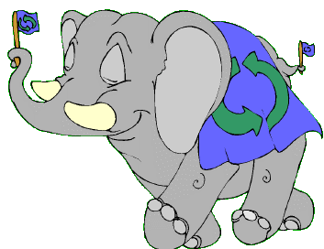
A logical XOR between previous binary numbers -
1101 1110 1110 0011
0011 0101 0010 1111
1110 1011 1100 1100

Slide 23

The Composite Gates
In addition to the basic gates, there are also three composite gates - NAND, NOR and XNOR.
These comprise -
an AND immediately followed by a NOT
an OR immediately followed by a NOT
an XOR immediately followed by a NOT
To perform the logical operation, just treat the numbers as a normal AND, OR or XOR, then reverse the result!

Slide 24
The Composite Gates
The logic gates for NAND, NOR and XNOR look like this -
The circle at the front always means that it is a composite gate!

Slide 25
The Truth Tables for NAND, NOR and XNOR -
0 | 0 | 1
0 | 1 | 1
1 | 0 | 1
1 | 1 | 0
0 | 0 | 1
0 | 1 | 0
1 | 0 | 0
1 | 1 | 0
A | B
0 | 0 | 1
0 | 1 | 0
1 | 0 | 0
1 | 1 | 1

Slide 26
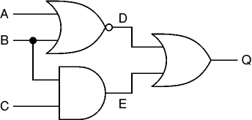
Logic gates are the basic building blocks of any computer system. Using combinations of logic gates, complex circuits can be constructed.

Slide 27
Practice Questions

Slide 28
Boolean Operators
Questions.
Q1. Evaluate the following Boolean logic operations
NOT 1010 1010
NOT 1111 1110
NOT 1100 0011
NOT 1111 0000 1111 0000

Slide 29
Boolean Operators
Questions.
Q2. Carry out the following binary operations.
1011 1101 OR 0000 1011
0010 1010 OR 0000 0001
1010 1111 OR 0101 1111
1011 1011 1011 1011 OR 0101 0101 0101 0101
0000 0000 1010 1011 OR 1011 1001 1010 1011

Slide 30
Boolean Operators
Questions.
Q3. Carry out the following binary operations.
1011 1101 AND 0000 1011
1010 1010 AND 0000 0001
1010 1111 AND 0101 1111
1011 1011 1011 1011 AND 0101 0101 0101 0101
0000 0000 1010 1011 AND 1011 1001 1010 1011

Slide 31
Boolean Operators
Questions.
Q4. Carry out the following binary operations.
1011 1101 XOR 0000 1011
1010 1010 XOR 0000 0001
1010 1111 XOR 0101 1111
1011 1011 1011 1011 XOR 0101 0101 0101 0101
0000 0000 1010 1011 XOR 1011 1001 1010 1011

Slide 32
Boolean Operators
Questions.
Q5. Carry out the following hex – binary Boolean operations.
NOT FFFF
F000 AND 8011
FF00 OR 000B
00A1 XOR F0B2

Slide 33
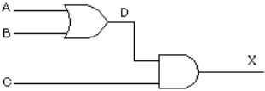
Boolean Operators
Questions.
Q6. Complete the truth table given below using the gates combination provided.

Slide 34
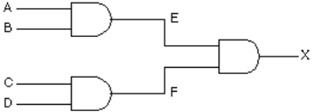
Boolean Operators
Questions.
Q7. Draw a truth table for the following set of gates, and confirm that it is ((A AND B) AND (C AND D)).

